Slide 1
Chapter: File-System Interface
Notes:
the file system is the most visible aspect of an operating system. It provides the mechanism for on-line storage of and access to both data and programs of the operating system and all the users of the computer system. The file system consists of two distinct parts: a collection of files, each storing related data, and a directory structure, which organizes and provides information about all the files in the system.

Slide 2
File Management
Process of storing, Controlling, Managing data stored on secondary storage in the form of files.
File Management:
  Ensure consistency of data when multiple users access the files
  Provides measures for file security and protection

Slide 3
File Concept
File is a sequence of bits, bytes, lines, or records, the meaning of which is defined by the file’s creator and user.
Field
Record
File
Data Base
Notes:
A file is a named collection of related information that is recorded on secondary storage. From a user's perspective, a file is the smallest allotment of logical secondary storage; that is, data cannot be written to secondary storage unless they are within a file. Commonly, files represent programs (both source and object forms) and data. Data files may be numeric, alphabetic, alphanumeric, or binary. Files may be free form, such as text files, or may be formatted rigidly. In general, a file is a sequence of bits, bytes, lines, or records, the meaning of which is defined by the file's creator and user. The concept of a file is thus extremely general
The information in a file is defined by its creator. Many different types of information may be stored in a file-source programs, object programs, executable programs, numeric data, text, payroll records, graphic images, sound recordings, and so on. A file has a certain defined which depends on its type. A text file is a sequence of characters organized into lines (and possibly pages). A source file is a sequence of subroutines and functions, each of which is further organized as declarations followed by executable statements. An object file is a sequence of bytes organized in.to blocks nnderstandable by the system's linker. An executable file is a series of code sections that the loader can bring into memory and execute.

Slide 4
File Attributes
Name – Name is usually a string of characters
Identifier – unique tag (number) identifies file within file system
Type – needed for systems that support different types
Location – pointer to file location on device
Size – current file size
Protection – Access Permissions, controls who can do reading, writing, executing
Time, date, and user identification – data for protection, security, and usage monitoring
Information about files are kept in the directory structure, which is maintained on the disk
Notes:
Name. The symbolic file name is the only information kept in humanreadable form. Identifier. This unique tag, usually a number, identifies the file within the file system; it is the non-human-readable name for the file. Type. This information is needed for systems that support different types of files. Location. This information is a pointer to a device and to the location of the file on that device. Size. The current size of the file (in bytes, words, or blocks) and possibly the maximum allowed size are included in this attribute. Protection. Access-control information determines who can do reading, writing, executing, and so on.
Time, date, and user identification. This information may be kept for creation, last modification, and last use. These data can be useful for protection, security, and usage monitoring.

Slide 5
File Operations
All operations involve some system calls
Create: using a specific system call. Two steps are necessary to create a file.
Open a file
Delete a file
Write in to file
Close
Reposition within file

Slide 6
Directory Structure
Symbol table of files that stores all related information about a file it holds with its contents
Directory
F 1
F 2
F 3
F 4
F n
Files
Both the directory structure and the files reside on disk
Backups of these two structures are kept on tapes

Slide 7
Operations Performed on Directory
Directory: collection of files or directories
A Symbol Table that translates file names into their directory entry.
Operations:
Search for a file
Create a file
Delete a file
List a directory
Rename a file
Traverse the file system : Search all directories/ sub directories and files

Slide 8

Directory Schemes
Single Level Directory
One directory many files
Single-Level Directory
Easy to support and understand.
Limitation:
When number of files increases or when the system has more than one user, then Naming problem occurs. All files should have unique names.
Disadvantage:
Difficult to remember the name of files when files increases
Single directory for all users
File names created by different users should be different.
Notes:
The simplest directory structure is the single-level directory. All files are contained in the same directory, which is easy to support and understand
gure 10.8). A single-level directory has significant limitations, however, when the number of files increases or when the system has more than one user. Since all files are in the same directory, they must have unique names. If two users call their data file test, then the unique-name rule is violated.
Even a single user on a single-level directory may find it difficult to remember the names of all the files as the number of files increases. It is not
uncommon for a user to have hundreds of files on one computer system and an equal number of additional files on another system. Keeping track of so many files is a daunting task.

Slide 9

Two Level
2. Two level directory, each user has his own user file directory(UFD).
UFDs have the similar structure, but each lists files of a single user.
Notes:
a single-level directory often leads to confusion of file names among different users. The standard solution is to create a separate directory for each user. In the two-level directory structure, each user has his own UFD. The UFDs have similar structures, but each lists only the files of a single user. When a user job starts or a user logs in, the system’s master file directory is searched. The MFD is indexed by user name or account number, and each entry points to the UFD for that user
Although the two-level directory structure solves the name-collision problem, it still has disadvantages. This structure effectively isolates one user from another. Isolation is an advantage when the users are completely independent but is a disadvantage when the users want to cooperate on some task and to access one another's files. Some systems simply do not allow local user files to be accessed by other users.

Slide 10

Tree Structure
Users can create their sub directories to manage the files.
Three has Root directory and files have unique file names

Slide 11
Paths
Absolute Path: Begins at the root and follows a path down to the specified file giving directory names on the path.
Relative Path: Defines a path from the current directory.
Creating a new file is done in current directory

Slide 12
Acyclic-Graph Directories
Multiple users can Have shared subdirectories and files
Users have their own working directory and may have one shared directory
Shared subdirectory created by one user in one directory is automatically visible to all users sharing that directory.
Shared directory or file may exist at multiple places simultaneously
Because of sharing, a file may have multiple absolute paths
So different names can refer to same file

Slide 13

Acyclic-Graph Directories

Slide 14
General Graph Directories
Created by adding links to the existing directory
Allows cycles in the same directory
As all files are dependent / linked deleting a main file may harm other files
In case of deletion: Garbage Collection is used
In First Pass: Traversing the entire file and marking everything that can be accessed
In Second Pass: Collect everything that is not marked as the free space

Slide 15
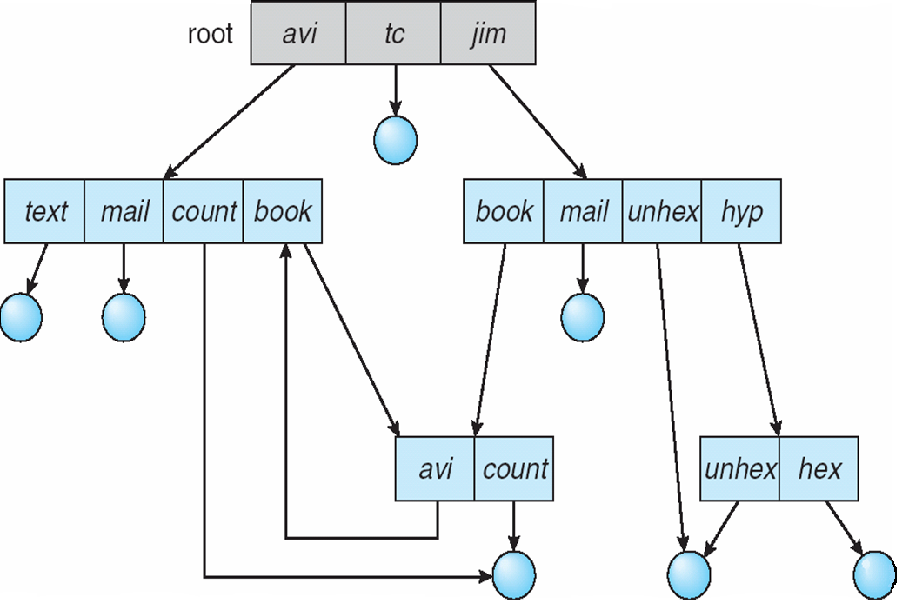
General Graph Directories
There can be cycle in the directory arrangement
General Graph Directory

Slide 16
Directory Implementation
Linear List
In this algorithm, all the files in a directory are maintained as singly linked list.
Each file contains the pointers to the data blocks which are assigned to it and the next file in the directory.
When a new file is created, then the entire list is checked whether the new file name is matching to a existing file name or not.
In case, it doesn't exist, the file can be created at the beginning or at the end. Therefore, searching for a unique name is a big concern because traversing the whole list takes time.

Slide 17
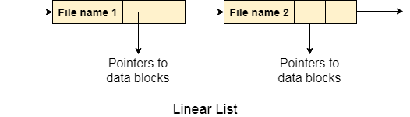
Directory Implementation
Linear List
The list needs to be traversed in case of every operation (creation, deletion, updating, etc) on the files therefore the systems become inefficient.

Slide 18
Directory Implementation
2. Hash Table
To overcome the drawbacks of singly linked list implementation of directories, there is an alternative approach that is hash table.
This approach suggests to use hash table along with the linked lists.
A key-value pair for each file in the directory gets generated and stored in the hash table.
The key can be determined by applying the hash function on the file name.

Slide 19
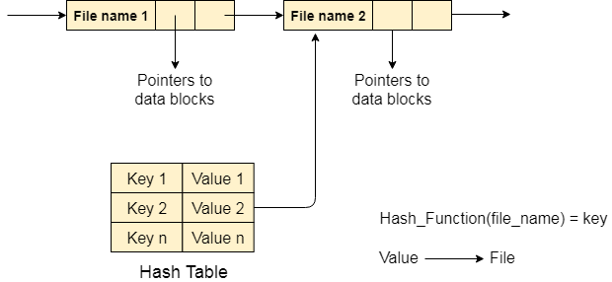
Directory Implementation
2. Hash Table
Now, entire list will not be searched on every operating.
Only hash table entries are checked using the key and if an entry found then the corresponding file will be fetched using the value.

Slide 20
Allocation Methods
Files are stored on disk
Main Issue is: how to allocate space to these files so that disk space is utilized effectively and file can be accessed quickly.
There are three major methods of storing files on disks:
  Contiguous file allocation
  Linked file allocation
  Indexed file allocation

Slide 21
Allocation Methods
Contiguous File Allocation
File occupy contiguous blocks
Directory entry contains: Filename, Starting block , Length (total blocks)
File Access possible: Sequential of data, Direct access of data
Problems:
Finding space for new file
External fragmentation
Determining space requirement of a file

Slide 22
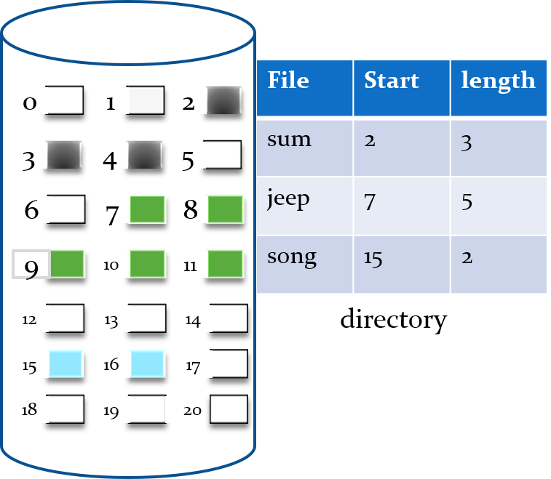
Allocation Methods
Contiguous File Allocation

Slide 23
Contiguous Allocation
Problems can arise:
  Finding space for a new file
  When files grow
  if the exact size of a file is unknown at creation time
  Suffers from problem of external fragmentation.
  Difficult to know how much space is needed for a file

Slide 24
Linked Allocation
Each file is a linked list of disk blocks
Disk blocks can be scattered any where in disk
Directory contains a pointer to first and last block of the file.
Exp: if file of 5 blocks might start at block 9, continue at block 16, then block 1, block 10 and finally block 25.
Each block contains a pointer to next block.
To create a new file , create a new entry in directory
Each directory has a entry has a pointer to first disk block of file.
Pointer is initialized to NIL and size / data part is set to 0

Slide 25
Linked Allocation
Disk files can be stored as linked lists
Linked allocation does not require pre-known file sizes, and allows files to grow dynamically at any time.
Drawback
It is efficient for sequential access files
To find ith block of a file, we must start at the beginning of that file and follow the pointers until we go to ith block.
Requires extra space for pointers
Problem with linked allocation is reliability:
  If a pointer is lost or damaged

Slide 26
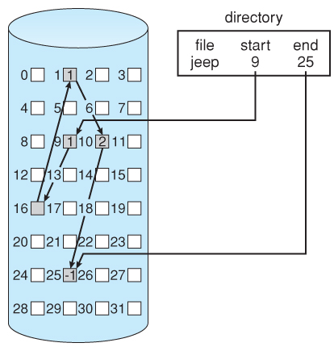
Linked Allocation

Slide 27
Indexed Allocation
Indexed Allocation combines all of the indexes for accessing file in a file.
Create a table of indexes
Index file contains pointers to blocks.
Bring all the pointers together into one location : Index Block
Each ith entry in index block points to ith block of the file
Create index of linked locations
Indexed allocation support Direct Access.
  Any free space on the disk can be used for allocation
  Removes external fragmentation

Slide 28
Indexed Allocation
Advantages:
  Any free space on the disk can be used for allocation
  Removes external fragmentation
Disadvantages:
  If index block is small, it will not be able to hold enough pointers
  Entire index will have to be kept in main memory to make it work

Slide 29
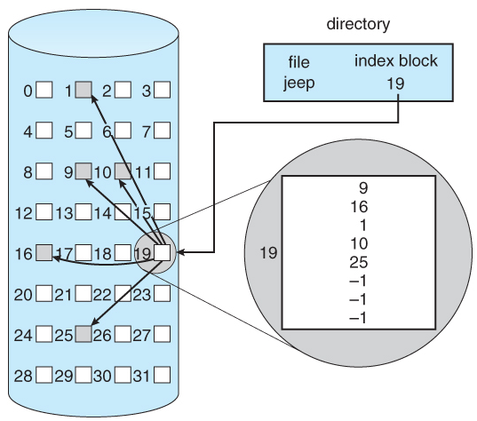
Indexed Allocation
-1 entry in block 19 means it can contain entries to two other data blocks.

Slide 30

Methods to implement free space list
Bit Map or Bit Vector
Each block is represented by a bit
If block is free, bit is set to 1 otherwise 0

Slide 31

Linked List
Linked list of all the free blocks is maintained
First free block in the list can be pointed by the head pointer
Disadvantage: Traversing is time consuming

Slide 32
Grouping
Grouping
Store addresses of n free blocks in the first free block
The first n-1 out of these are free while nth block contains addresses of another n free blocks.
E.g., Block 2 contains address of next 5 free blocks (3, 4, 5, 9, 10) out of which blocks 3, 4, 5 and 9 are free while block 10 contains the address of next five free blocks.

Slide 33
Grouping
4. Counting:
This method keeps the address of first free block and number of free contiguous blocks that follow the free block.
Notes:
we can keep the address of
the first free block and the number (n) of free contiguous blocks that follow the
first block.
(X100 + 10 free blocks)

Slide 34
MCQ
The data structure used to implement directory is____________
a) mount table
b) hash table
c) file table
d) process table
Notes:
b

Slide 35
MCQ
If the block of free-space list is free then bit will ____________
a) 1
b) 0
c) any of 0 or 1
d) none of the mentioned
Notes:
a

Slide 36
MCQ
What will happen in the single level directory?
a) All files are contained in different directories all at the same level
b) All files are contained in the same directory
c) Depends on the operating system
d) None of the mentioned
Notes:
b

